Slide 1
TRAIN TICKET GENERATION

Slide 2
Problem Statement
This Project involves generating a train ticket and printing the ticket to a File. The application is taking train number and passenger details as input.
The details of the train are stored in a database. The train details are fetched from the database using the train number provided by the user.
The passenger name, age and gender are accepted from the user.
The application should generate a train ticket using the train details and passenger details.
The generated ticket should be written to a File.

Slide 3
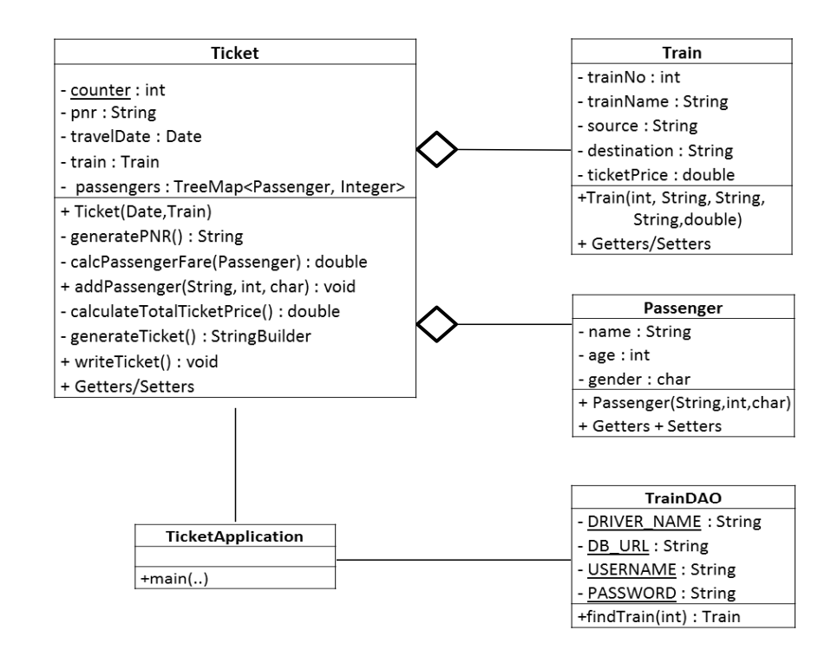
Project Workflow

Slide 4
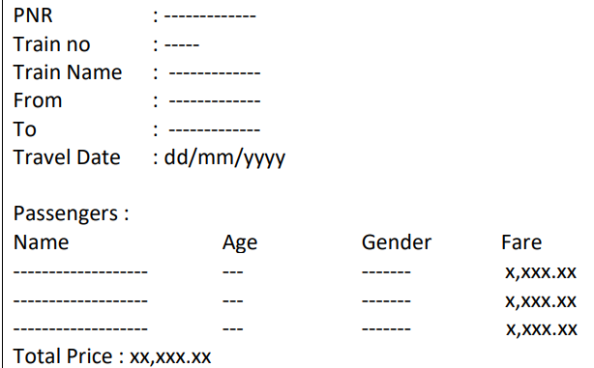
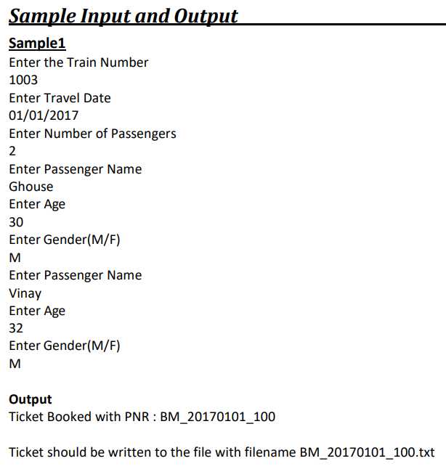
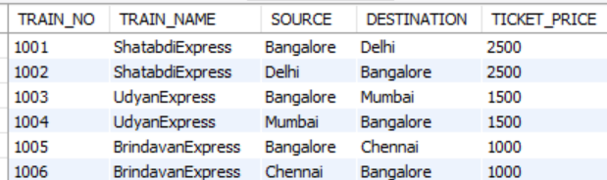
Fig1: Ticket Format
Fig2: Train Database

Slide 5
Contribution
Name | Work
Rounak Bhadra | Generating PNR and Calculating passenger fair as per age
Smriti Rani | calculating total ticket price
Usama Sukri | Ticket Generation
Darshan Marakall | Writing ticket into File
Kannappagoud | Connecting to Database
Sagar Deshmukh | Getting train details

Slide 6
Generating PNR and Calculating passenger fair as per age
PNR for train from Bangalore to Mumbai with travel date 21/01/2017 would be BM_20170121_100.
The ticket Fare for each passenger is calculated using the following rules
For age < = 12, fare is 50% of ticket price regardless of gender .
For age > = 60, fare is 60% of ticket price regardless of gender .
For Females, 25% discount on the ticket price.

Slide 7
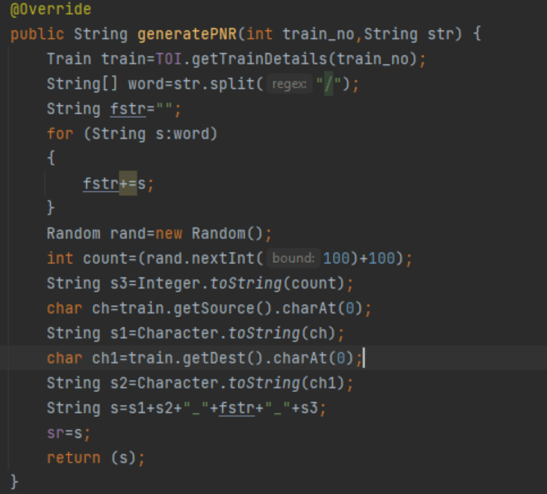
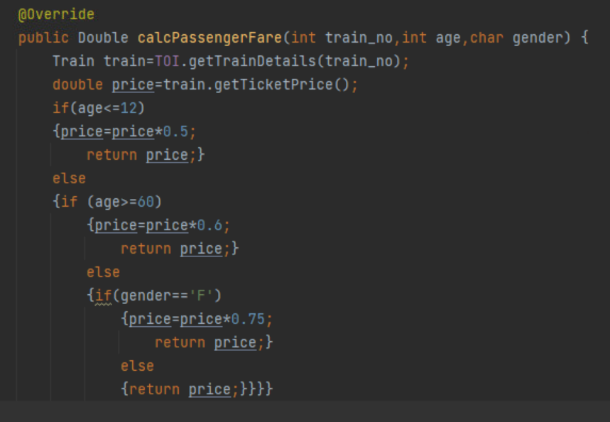

Slide 8
Calculating total ticket price
All the passengers with their fair according to their age were stored in a Tree Map.
In Tree Map ,passenger is the key and fair is the value.
Passengers were sorted according to their name in the final ticket.
Total ticket price is calculated by summing up all the individual ticket prices.

Slide 9
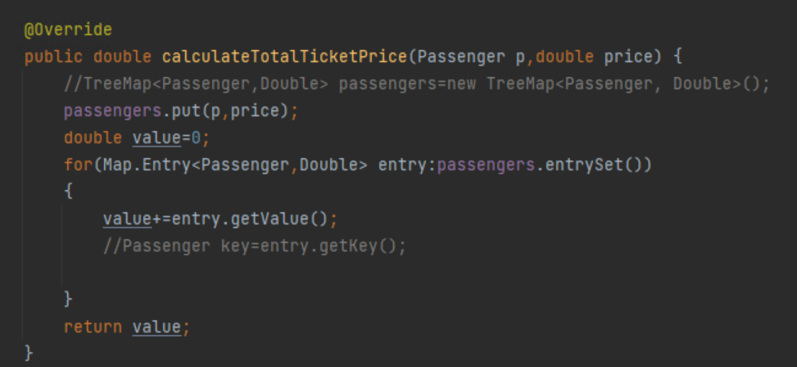
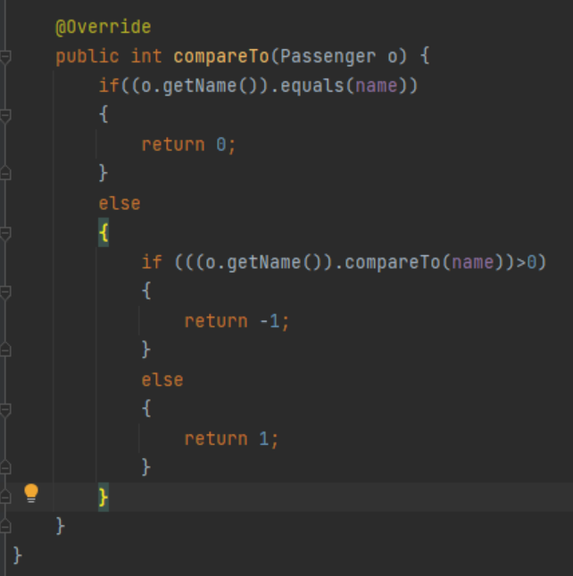

Slide 10
Ticket Generation
The application should generate a train ticket using the train details and passenger details. The generated ticket should contain the following details •
PNR Number, Travel date, Train Number, Train Name, Source Station, Destination Station •
Name, age, gender and ticket fare for each passenger •
Total Ticket price

Slide 11
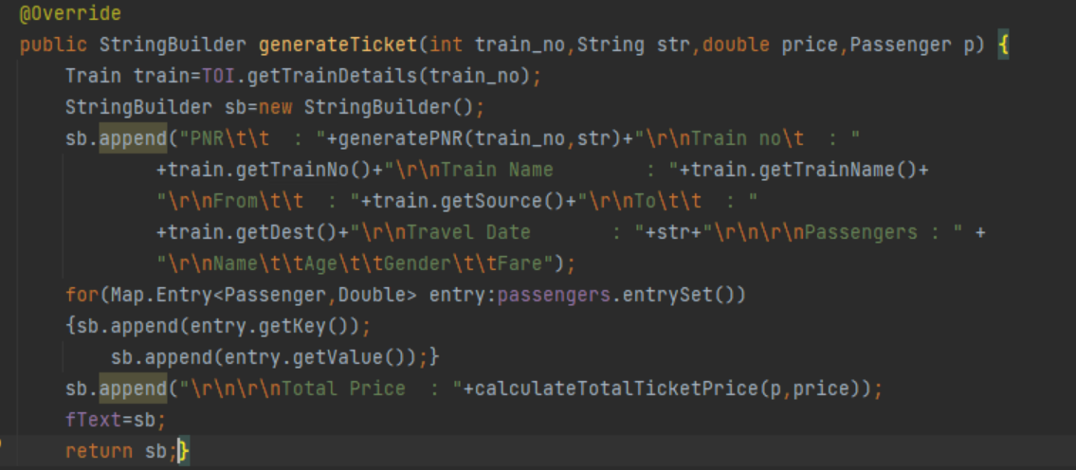

Slide 12
Writing ticket into File
The generated ticket will be stored in a file.
The format of the ticket is same as the ticket which has been generated earlier.
The filename is the same name as the PNR no. of the ticket.

Slide 13
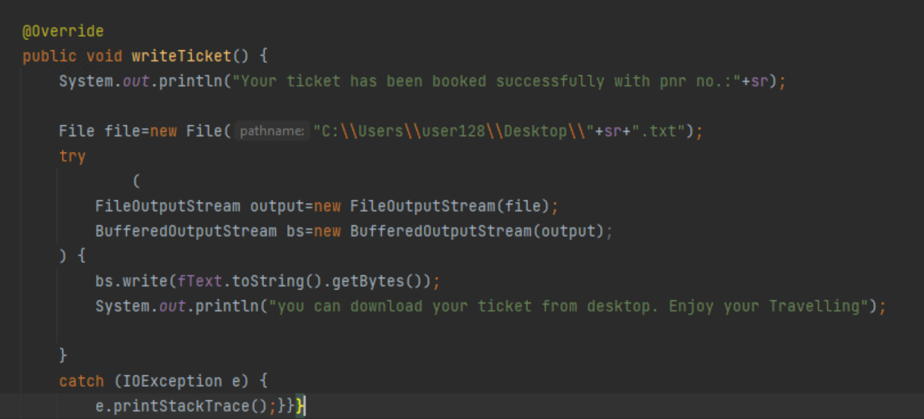

Slide 14
Connecting to Database
Here we have used MYSQL workbench to store the train details.
The URL of the train database is passed to connect the database with JDBC project.

Slide 15
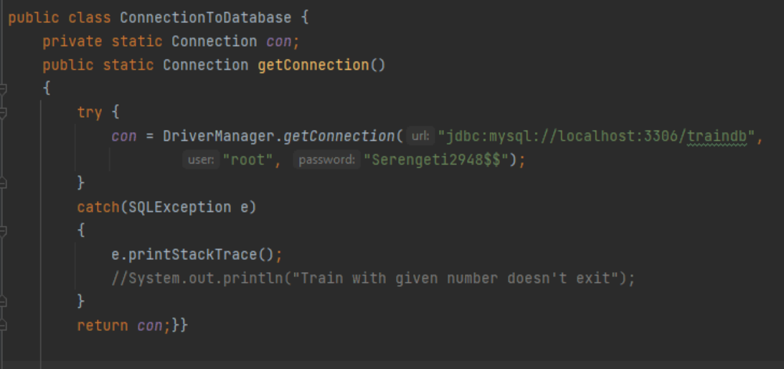

Slide 16
Getting train details
The train details are fetched from the train database by using executeQuery statement.
Train details are getting fetch according to the order in which they are present in the database.
Train not found will be printed once the user give invalid train number.

Slide 17
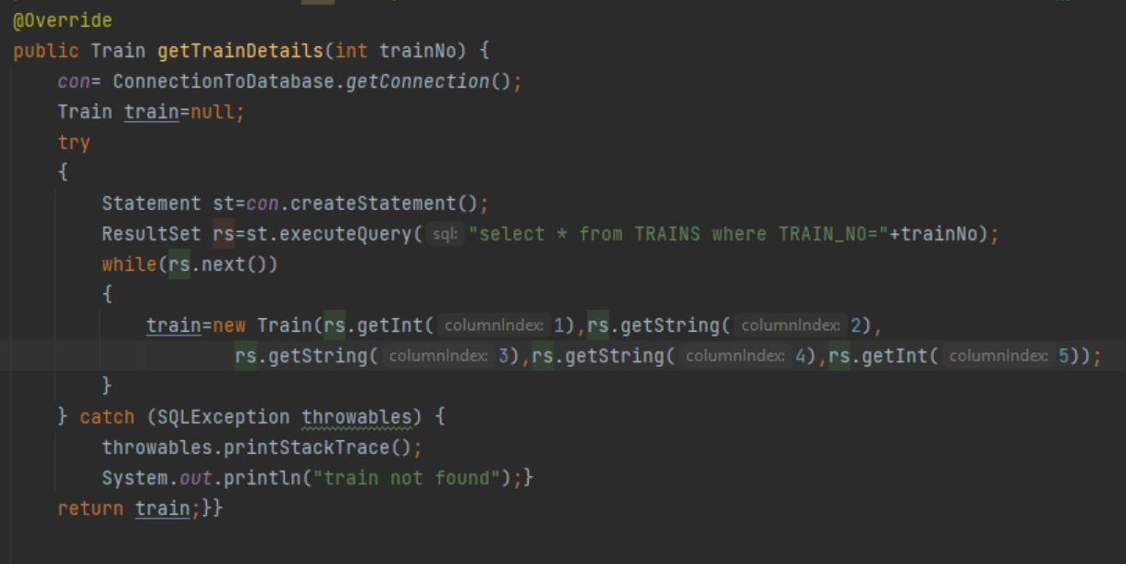

Slide 18
FRONT END
The front end part involves the following pages:
Login page
Train Details
Book Ticket
Ticket Confirmation
Ticket Download and Exit

Slide 19
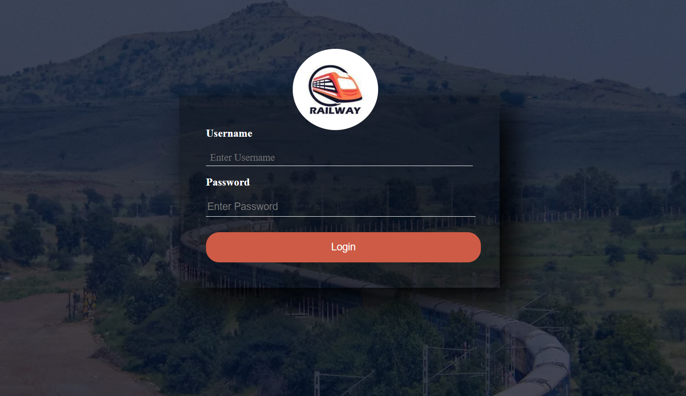
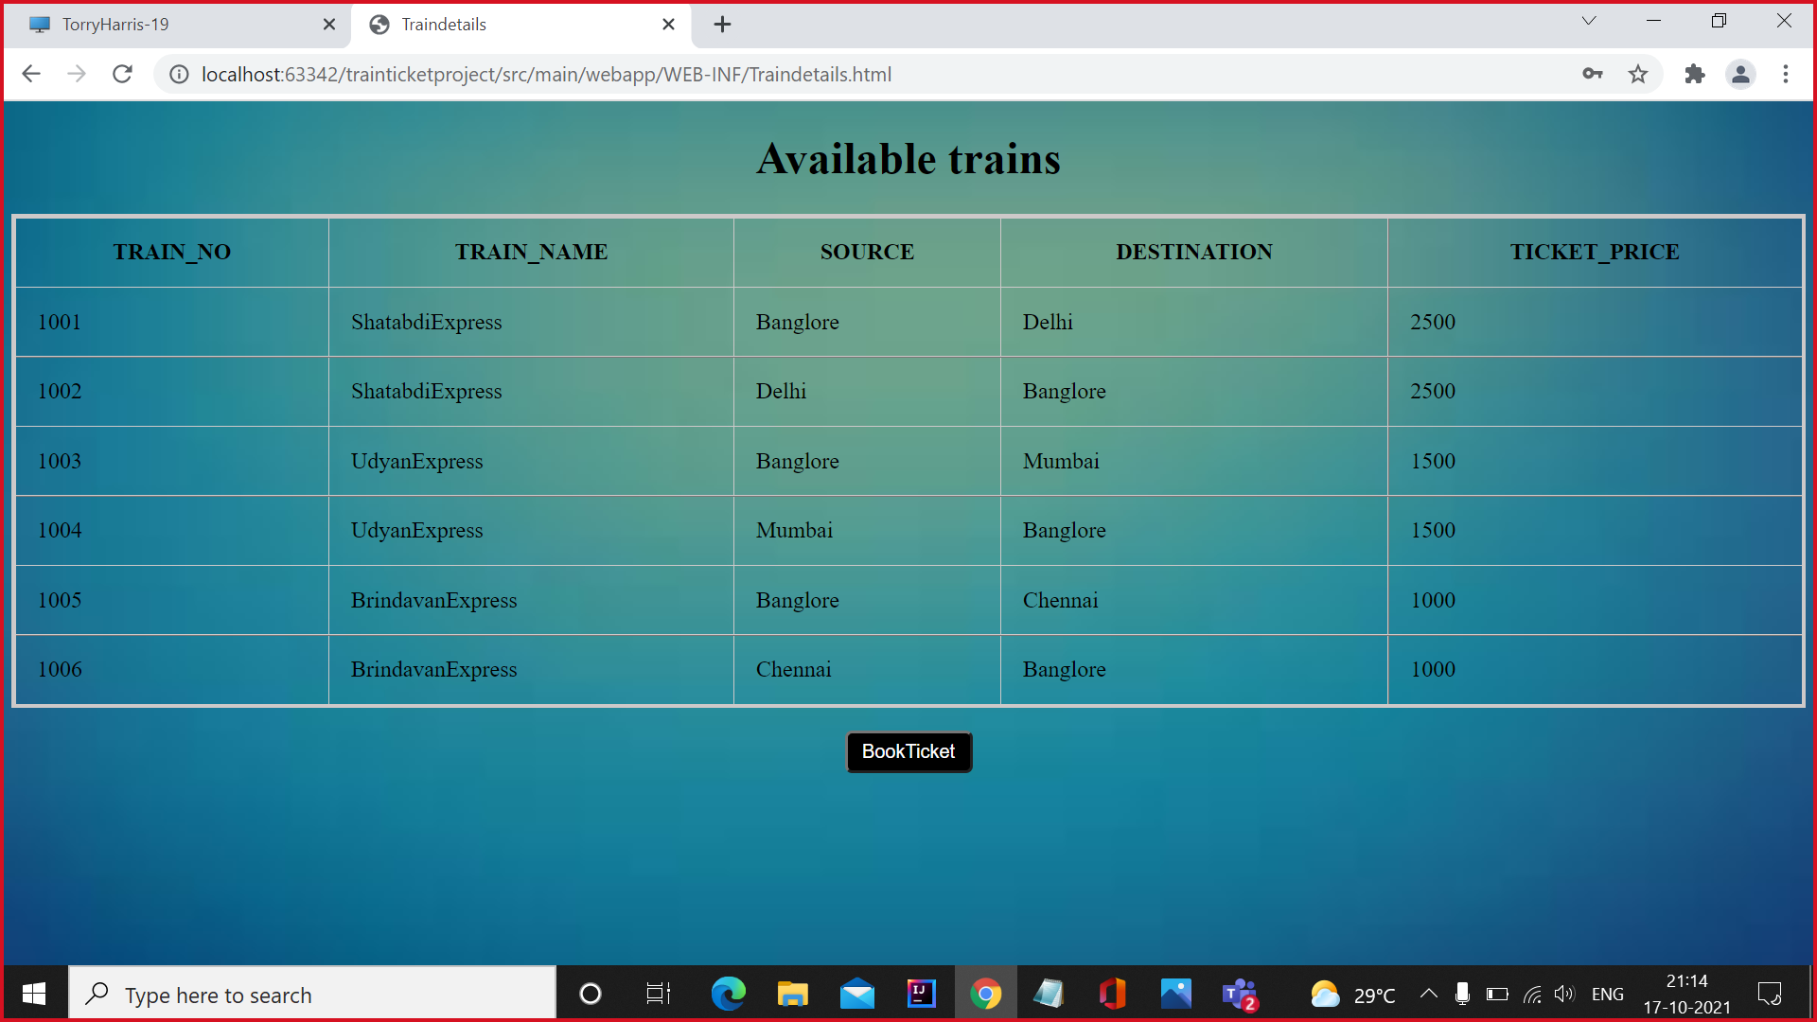
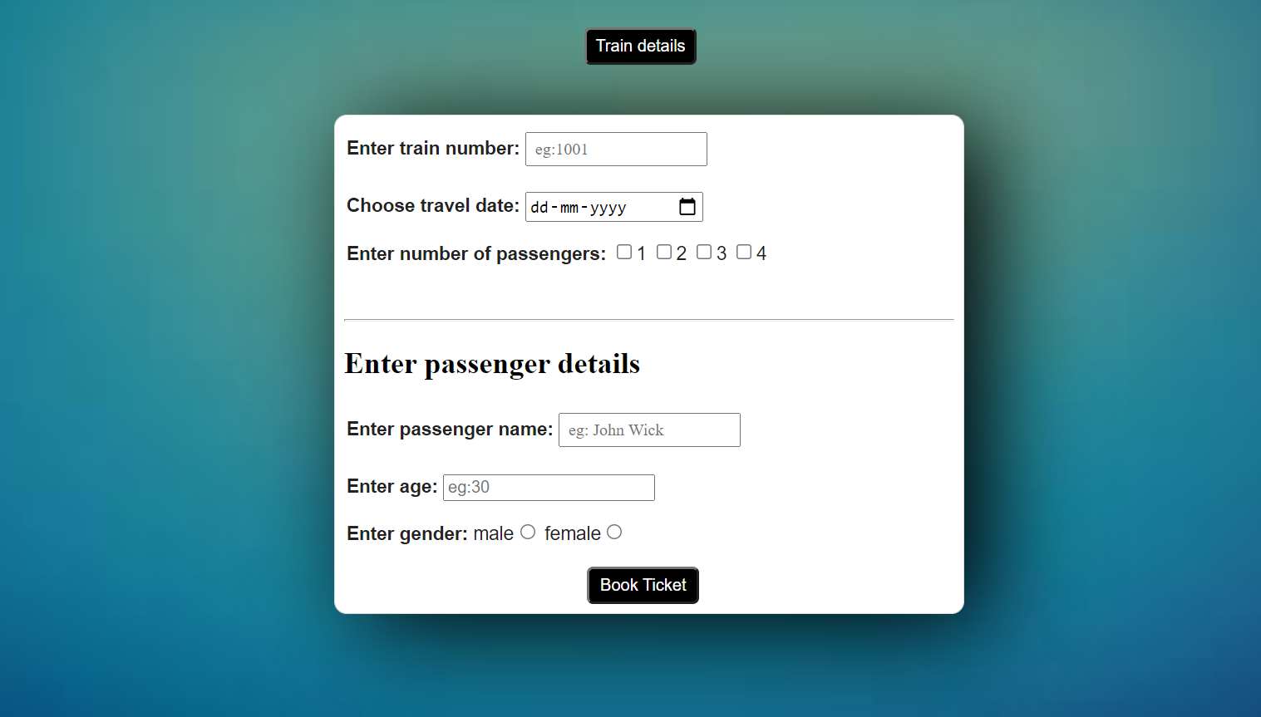
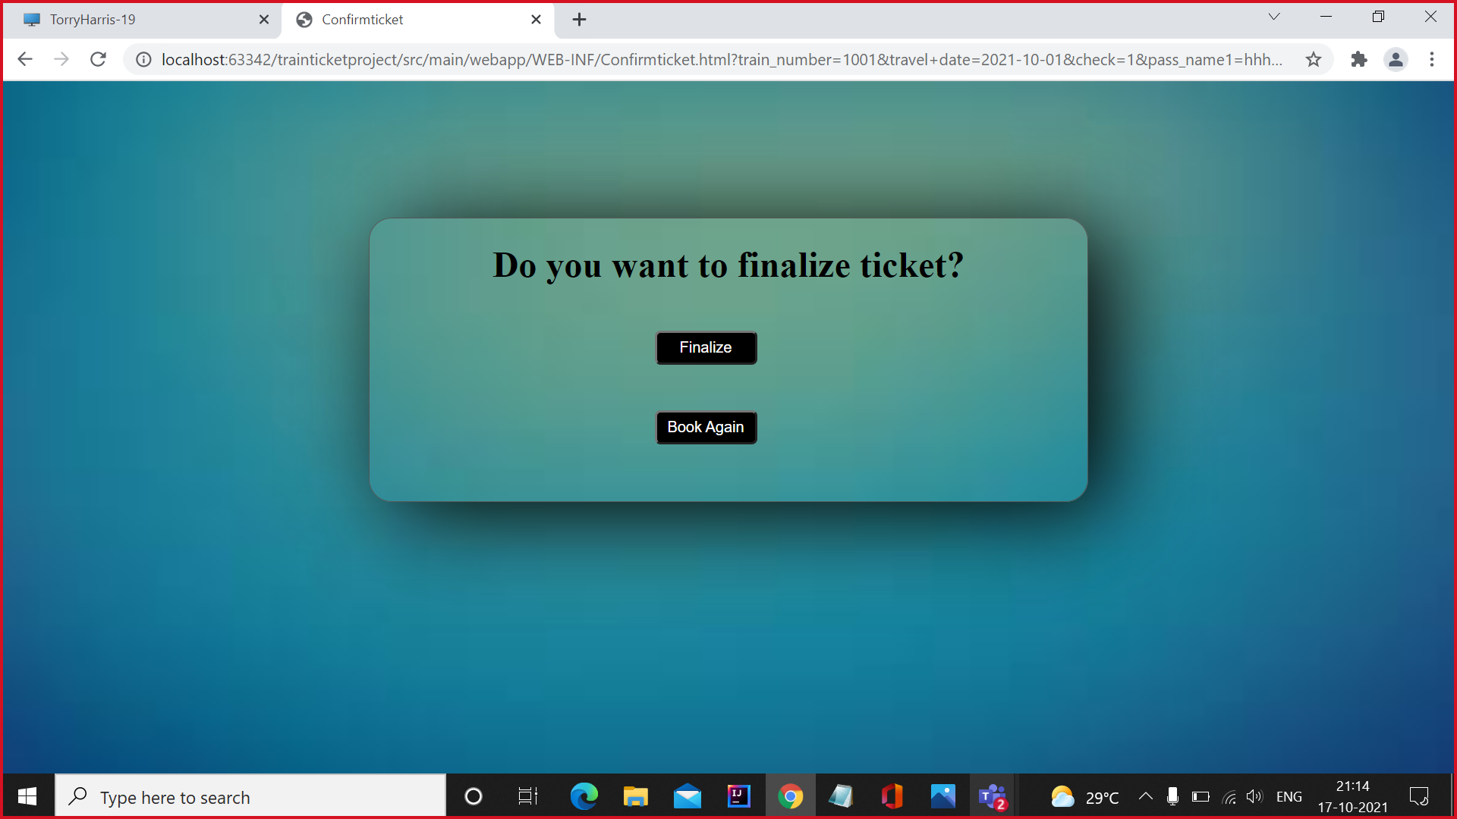

Slide 20
Acknowledgement
We would like to express our special thanks of gratitude to our mentor Mrs. Mythili Ma'am who gave us the guidance to do this wonderful project on Train Ticket Generation, which also helped us in doing a lot of research and we came to know about so many new things we are really thankful to her.
Secondly we would also like to thank Torry Harris Integration Solutions for giving this learning opportunity which helped us a lot in finalizing the project within the limited time frame.

Slide 21
Conclusion
We have successfully created Train Ticket Generation project right from creating database to connecting that to java project using JDBC .
We have also created the web page according to project requirement and everything is working fine.
We are looking forward to merging our backend with the front end using spring boot within next few days once we are completed with the spring boot module training.

